Slide 1


SAP UI5 & FIORI with OData TRAINING
Anubhav Oberoy
Day – 10

Slide 2

Agenda – Day 10
Introduction to manifest.json
Understanding the structure of manifest.json
Introduction to List Control in UI5
Types of List Control
Binding of List control
Understanding the List Modes
Understanding how to search data using Search Field
Introduction to the Data Filtering
Adding toolbar in the application.
Showing a Message Box.
Introduction to Worklist Fiori Application
Icon Tab Bar and Icon Tab Filter
Drop Downs in ui5
Introduction ot Mater Detail Application
Introduction to Router and Routing
Understanding the use of Route Match Handler
Using SAP mobile table
Working with Messages in UI5

Slide 3
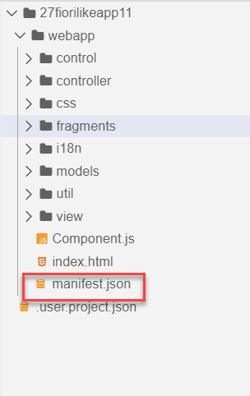
Concept of manifest.json in UI5
manifest.json is also knows as application descriptor file. It contains all the configuration for our app centrally.
Some attributes in the descriptor are just for information purposes, such as the minimum OpenUI5 version (minUI5version), others help external components (for example the SAP Fiori launchpad (FLP)) to integrate the application correctly, but most of the attributes are actually used to configure specific aspects of the app that are needed frequently.
It is written in JavaScript Object Notation (JSON) format.
We recommend that you use the manifest.json file to configure the app settings and put
all important information needed to run the app in there. Using this approach means
you need to write less application code, and you can already access the information
before the app is instantiated.
Everything which is needed for an app to start, load, move, run, configure,
requires is inside manifest.json.

Slide 4
Three Sections of manifest.json
sap.ui5 contains different components
rootView, dependencies, contentDensities, models, routing etc.
sap.ui5
sap.app contains idtype, i18n, applicationVersion, title, description, dataSources.
sap.app
sap.ui contains technology, icons, deviceTypes, supportedThemes
sap.ui

Slide 5
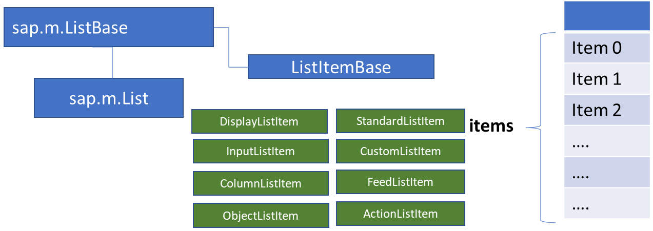
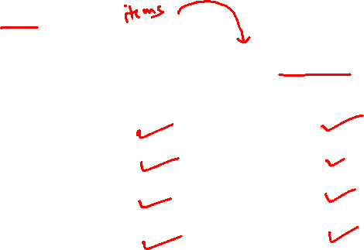
List Control
The list contains various list items. These items can be of various types depending on the use case and on the content they have. SAPUI5 already provides the most common list items in SAP Fiori in the form of controls, although custom list items can also be created if necessary.
Reference: https://sapui5.hana.ondemand.com/#/entity/sap.m.List
A List control is a single column table with multiple items inside. We will have a list header and items as aggregation.

Slide 6
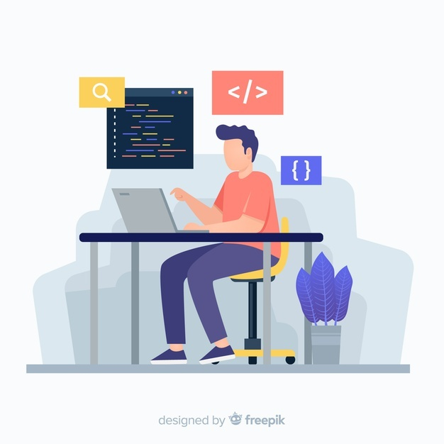
Exercise: Basic List Controls
In this Exercise we will add some commonly used list controls to the view. We will also see how to use the samples given in the UI5 SDK.
Exercise code/resource:-
View1.view.xml

Slide 7
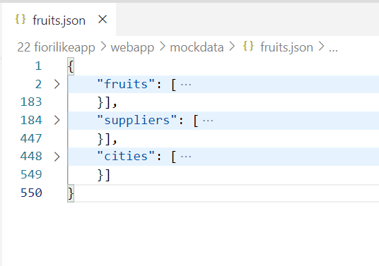
Binding List Items
Now we will bind the list form some demo data. But before we start, we need some demo data in json file. The data is provided in exercise as fruits.json.
It contains 3 entity sets:
fruits – name, color, type (neutral, citrus, alkaline),price, currency, unit, availability (available, discontinued, out of stock), season, photo (url from google) - 20
cities – name, state, famousFor, population, lat, lng -10
supplier – name, contactPerson, contactNo, sinceWhen, city, speciality :[“name of fruits”] -10

Slide 8
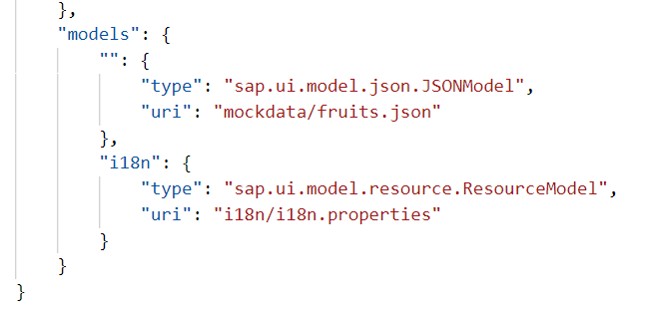
Model Instantiation
The app configures several data models that are used throughout the app to update the views or to store additional configuration options.
The service model and the resource bundle are instantiated automatically by the app’s component during startup and described in the first section. The local view models and helper models such as the device model are set up as JSON models and described in the second section.
Automatic Model Instantiation
The templates instantiate the service and resource model automatically using the following configuration entries in the descriptor. When the component of the app is initialized, these models will be made available under the configured name throughout the app.
An external service is defined in the dataSources section of the sap.app namespace. In the example shown below, we configure an OData with protocol version 2.0 and the alias "mainService" in the manifest.json file:

Slide 9
List Modes
The mode property defines the appearance of the left area of a list item.
Lists have properties and events and they contain list items that inherit from sap.m.ListItemBase, which provides navigation, selection and event features.
Delete
SingleSelect
01
04
only one list item can be deleted via provided delete button
Right-positioned single selection mode (only one list item can be selected).
01
04
MultiSelect
You can edit this text
SingleSelectLeft
02
05
02
more than one list item can be selected
05
Left-positioned single selection mode (only one list item can be selected).
03
06
None
03
06
SingleSelectMaster
no selection
Selected item is highlighted but no selection control is visible (only one list item can be selected).

Slide 10

Exercise: Object List Item with demo data
In this exercise we will Instantiate our model in Manifest.json and then bind the newly created model with the List in the view.
Along with that we will also use some formatter in the list.
Exercise code/resource:
View1.view.xml
manifest.json
fruits.json
formatter.js

Slide 11
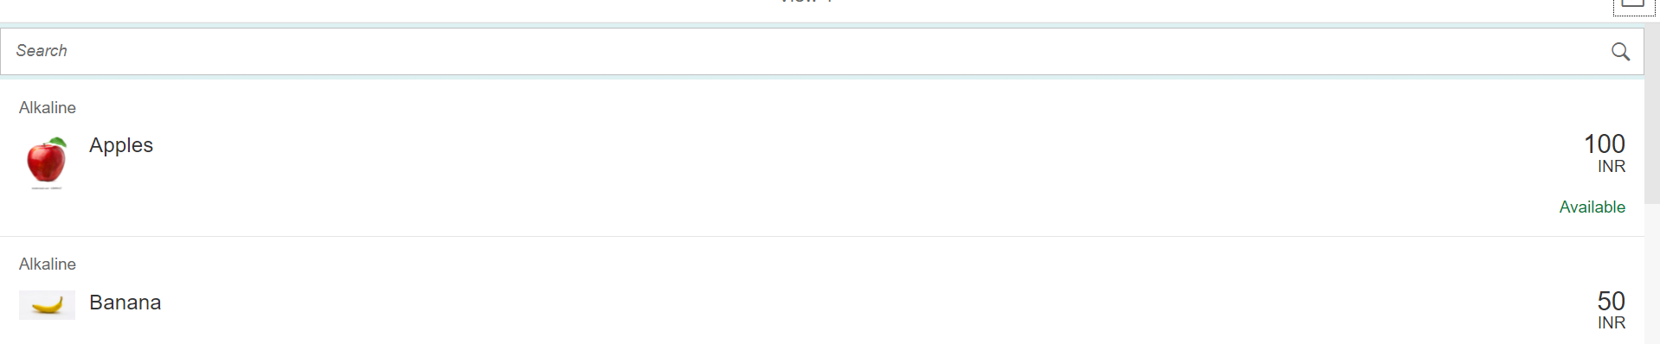
Exercise - Using Search Fields to Filter Data
Nowadays we come across many web pages that provide data in the form of lists or tables. These lists are enabled with search functionality, i.e., as the user types in into the search field and press enter then the data in the list is filtered according to the value in search field.
In this exercise we will implement the search functionality in our application to filter data in fruits list.
Exercise code/resource:
View1.view.xml
View1.controller.js

Slide 12
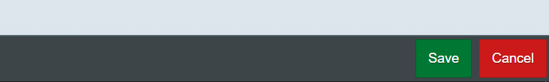
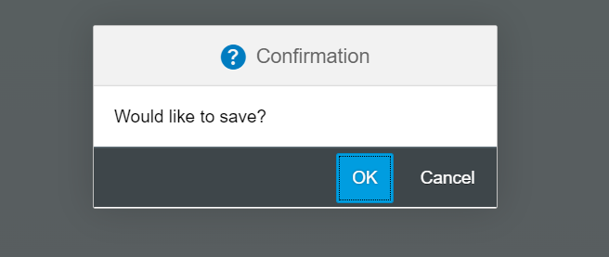
Exercise – Toolbar & Message Box
Toolbar:- A toolbar is a set of icons or buttons that are part of a software program's interface or an open window.
Toolbars have items such as Back and Forward buttons, a Home button, and an address field.
MessageBox: - The message box (sap.m.MessageBox) is a special dialog that allows you to display messages to the user. Compared to the message popover (sap.m.MessagePopover), you can use the message box to display messages that are not related to a field on the UI, such as technical errors.
In this exercise we will add a footer toolbar on the View2, in that toolbar we will also add to buttons and on click of that buttons we will open a MessageBox.
Exercise Code/Resource:
View2.view.xml
View2.controller.js
Header Toolbar
Footer Toolbar
Message Box

Slide 13
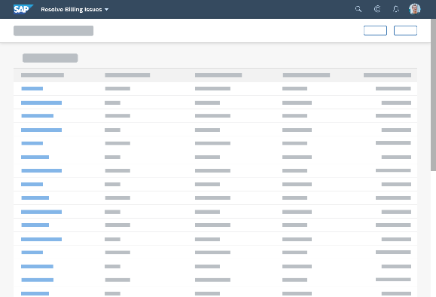
Introduction to Worklist Application
A worklist displays a collection of items a user needs to process. Working through the list usually involves reviewing details of the items and taking action. In most cases, the user has to either complete a work item or delegate it.
When to use:
Users have numerous work items and need to decide which ones to process first.
You want to give users a direct entry point for taking action on work items.
Users need to work with multiple views of the same content (for example, items that are “Open”, “In Process”, or “Completed”). You want to offer tabs for switching between views.
Detail View
List Page

Slide 14

Exercise: Work List Application
Now we will make over application a worklist application.
When we select a fruit in the list on the view1 the details of that fruit will be visible on the View2.
Exercise code/resources:
View1.view.xml
View1.controller.js
View2.view.xml

Slide 15
App
Split App Container
Master Pages
Detail Pages
V1
V2

Slide 16
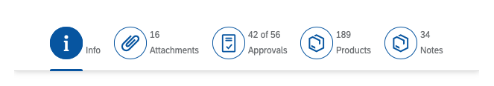
Icon Tab Bar and Icon Tab Filter
The icon tab bar comprises a series of tabs that each link to a different content area or view. You can use it for navigation within an object, or as a filter.
The IconTabBar represents a collection of tabs with associated content.
The IconTabFilter holds all information on an item - text, icon and count.
The IconTabBar can be used for navigation within an object, or as a filter. Different types of IconTabBar are used based on the contents.
Filter - There is only one main content for all tabs. The main content can be filtered, based on the selected tab.
Normal tab bar - The contents of each tab are independent from each other.
Combination of the above - There can be both filtered and independent contents.
There are two key use cases:
You want to let users navigate between different object facets in the object details area.
You want to let users filter lists, and give them the option of calling up the entire list, or only items with a specific attribute.
In both cases, the user switches between tab pages by clicking the respective tab.

Slide 17
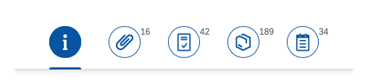

Exercise: Icon Tab and Icon Tab Filter Bar
In this exercise we will add a Icon tab bar in the fruit detail page. We will add three tabs in it as More Info, Supplier and Cities.
In More Info Tab we will add a Simple Form.
In Supplier Tab will add a empty table for now and in Cities tab a plain text field.
Exercise code/resources:-
View2.view.xml

Slide 18

Exercise - Drop Downs in UI5
UI5 provides us different type of Dropdowns like Select box, ComboBox and MultiComboBox etc.
In this Exercise we will add there three controls in the Cities tab in View2 and bind these controls with our cities data model.
Exercise code/resources:
View2.view.xml

Slide 19
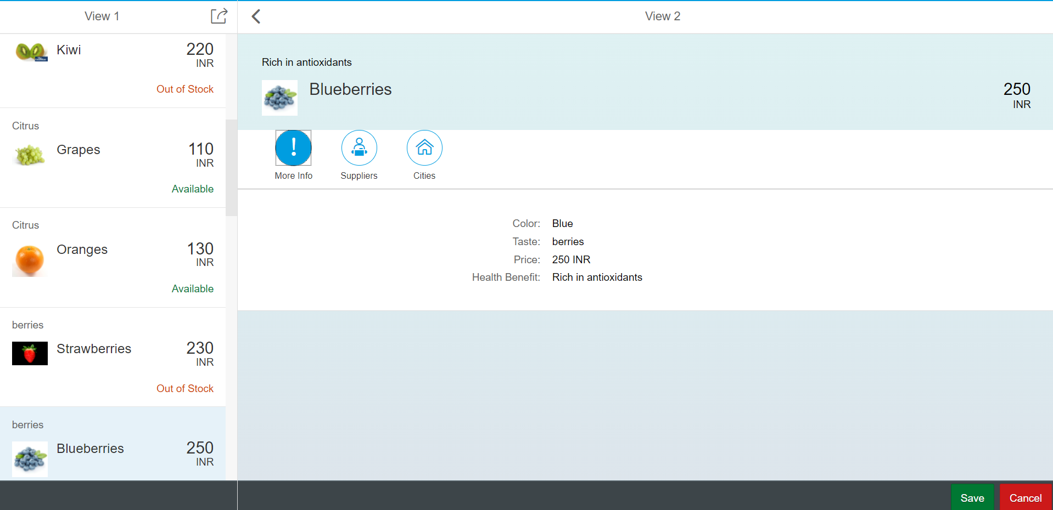
Introduction to master Detail Application
The SAPUI5 Master-Detail Worklist Application template implements a typical split-screen layout, one of the design patterns that is specified by the SAP Fiori Design Guidelines.
The split-screen layout is optimized for displaying and processing a list of items. On the left side of the screen, users can quickly scan and navigate through the list. On the right side, they then see the details of the selected item, and can trigger related actions or edit the data.
The main control of this app is the sap.m.SplitApp control that displays the Master view with a list of objects on the left side and the Detail view on the right side. When the user presses an object in the master list, the detail page is updated with the context of the selected item.
The Master view shows the current number of items and a search field that can be used to search through the list items. The number of items are updated automatically and the search filters for a preconfigured field of the list.
The Detail page contains a simple object header displaying more details for the selected object, an empty sap.m.IconTabBar that can be enriched with custom app content, and a table of line items that are associated to the selected object in the data model.

Slide 20
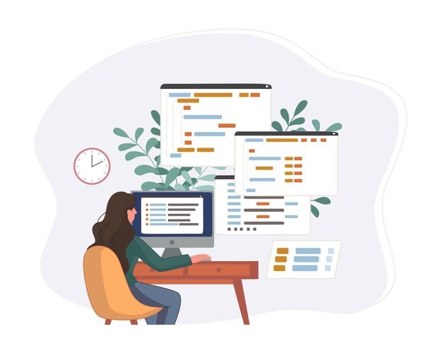
Exercise: Master Detail App
Now we will make our application a master detail Application. For this Exercise we will change our App view.
In app view instead for using App control we will use Split App control.
Exercise code/resources:-
App.view.xml
Component.js

Slide 21
Problem in our Fiori Like App - Navigation
When we press browser back and forward button, they should work correctly. Basically the back button should load the immediate back step just before navigation.
When a internet failure happens, before that we were at a particular state of the app and when app comes back online or refresh happens the app starts all over again, this will be annoying to user.
When we copy URL of our app and give it to someone, we were at a deeper navigation of an app. When we give the URL to them, it should reload the state of the application. Like AMAZON, FB PROFILE.
Instantiating view at the beginning is a high cost of memory consumption. When we go to a particular screen only then we need to create view object.
There is no standard followed to create view objects, each developer may write view codes inside different files eventually making is hard for fellow developers/successors to maintain the software.
The function to create view object sap.ui.view is deprecated.
A developer can create view objects in Fiori app at different places. This makes very hard for successor to take handover of these apps because they all are built differently eventually the same work. Missing standard.
All the view objects are created at once, there is no guarantee that a user will go to our view or not still we consume memory by creating them.
We have merged the code of one view inside another view, this brings tight coupling which makes it vary hard in future to decouple code and manage it.
I was reading online sap.ui.view is deprecated, why are we still using it, what is right way to create my view object.

Slide 22


Router and Routing
Router is a class provided by SAP and its object is readily available with the base class of Component. It will be responsible for creating our view objects as well as navigation of entire app. In past, we used to use event bus concept.
Steps :
We need to get the router object in Component JS from its base
Call initialize method using this object
The initialize method will SCAN manifest.json to find the routing configuration
Define the rootView configuration which will initialize our App.view.xml
Define the route configuration and targets to initialize and setup our navigation path between views
Router

Slide 23
Routing Configuration
Routing Configuration is defined in manifest.json file. It is defined under the “sap.ui5” section.
Routing configuration consists of routes, targets, config, and owner.
rootView
config
routes
targets
This section contains the information about our Root View. The View which works as a container for other views. In this section we provide the path of the view, type and controlId.
This section contains the global router configuration and default values that apply for all routes and targets. We define the router class that we want to use and where our views are located in the app.
Each route defines a name, a pattern, and one or more targets to navigate to when the route has been hit.
Three subsections :-
1. pattern
2. name
3. target
A target defines a view that is or more routes displayed, it is associated with one.
Subsections: -
Overview
detail

Slide 24
Navigation and Routing
Navigation and routing is essential in modern single-page applications such as apps built with SAPUI5.
In classical web applications, the server determines which resource is requested based on the URL pattern of the request and serves it accordingly. The server-side logic controls how the requested resource or page is displayed in an appropriate way.
In single-page applications, only one page is initially requested from the server and additional resources are dynamically loaded using client-side logic. The user only navigates within this page. The navigation is persisted in the hash instead of the server path or URL parameters.
Sap.m.routing.Router is the class used for Routing and Navigation purpose in SAP UI5 framework.
“Pattern” defines the hashtag that needs to be added at the end of the URL when it is hit.
“name” defines a unique name for the particular route.
“target” defines the target which is defined in targets section

Slide 25

Exercise: Routing
In this exercise we will add router to our application we will also see how to add routing configuration in the manifest.json file.
To Enable routing we have to initialize the router in Componenet.json file. Along with that we have to remove the Create content function form the Componenet.json file.
We will also add a new view in the application named as empty view.
For now we will implement the router without binding the view with the path.
Exercise code/resource:-
manifest.json
Component.js
View1.controller.js
Empty.view.xml
Empty.controller.js

Slide 26
Route Match Handler
SAPUI5 offers a hash-based navigation, which allows you to build one-page apps where the navigation is done by changing the hash, so the browser does not have to reload the page. Instead there is a callback to which the app and especially the affected view can react. This callback is known as Route Match Handler.
Route Match Handler is called every time when the route is triggered.
Exercise code/resources:
View1.controller.js
View2.controller.js
manifest.json

Slide 27
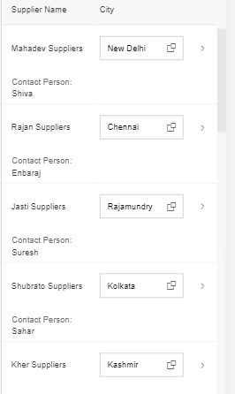
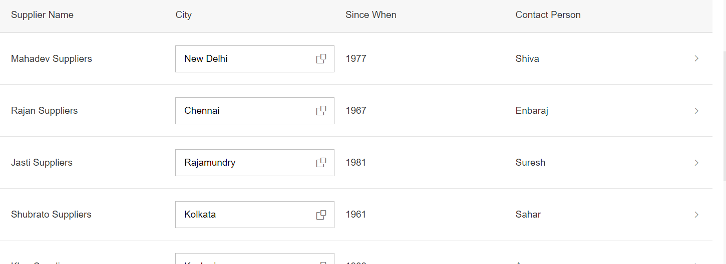
Working with Mobile Table
The responsive table is the default table in SAP Fiori. It contains a set of line items and is fully responsive. Depending on the scenario, users can also navigate from the line items to further details.
The responsive table is optimized for viewing one line item at a time with no scrolling or only vertical scrolling, irrespective of the display width.
On smartphones, only the most important data remains in the one-column or two-column table, while all other data is moved to the space between two item rows, known as the “pop-in area”.
In this area, data for the corresponding cell is provided as a label/value pair. The label is defined by the column header, and the value is taken from the corresponding cell. Labels can be displayed next to the value or above the value.

Slide 28
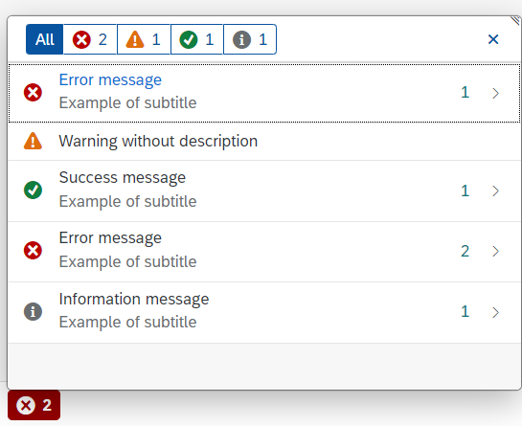
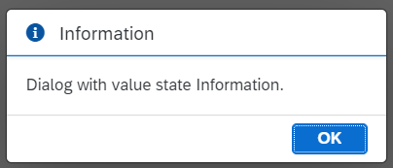
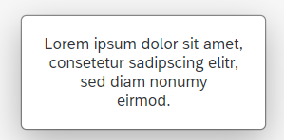
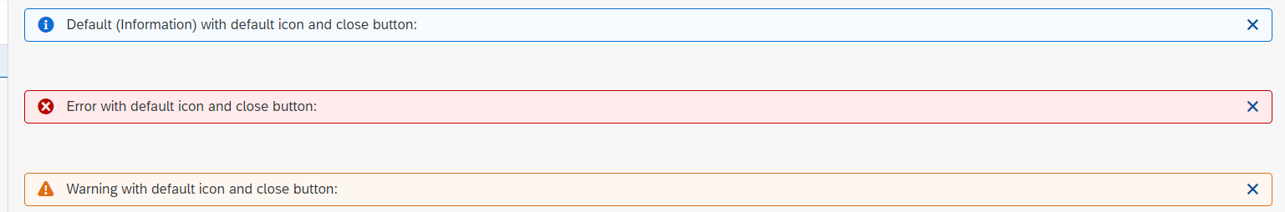
Working with Messages
The system generates messages in response to what users do in the SAP system. A message presents information, an instruction, or a warning to users in a given situation.
Messages can be used to notify the user about specific states of the application and can help the user to correct their incorrect inputs.
For showing messages to the user that are related to the current page, you have several possible controls. Each of these offers a different type of interaction from the user. Choose the control that fits best in you interaction pattern.
Message Dialog: A message dialog interrupts the user's workflow by blocking the current page and needs to be closed by the user.
Message Toast: A message toast is an overlay that disappears after some time or if the user taps somewhere else. It does not block the user.
MessageStrip: MessageStrip enables the embedding of short application-related messages in the application. There are four types of messages and each is color-coded and has an icon corresponding to its type: Information, Success, Warning and Error.
MessagePopover: MessagePopover displays a summarized list of different types of messages (errors, warnings, success and information). It provides a handy and systemized way to navigate and explore details for every message.

Slide 29

Exercise: Mobile Table and Message Toast
In this exercise we will add a Mobile table in the supplier section of the Icon tab bar. In the header of the Table we will add a filter button. On click of that button we will display a some messages.
Exercise code/resource:
View2.view.xml
View2.controller.js

Slide 30

End of Day 10

Slide 31

Questions

Slide 32

Anubhav Oberoy

Slide 33


We’re committed to empower you to be
Most Desirable Resource
through powerful training solutions.
We build the workforce of the future.
250+
Corporate Clients
30,000+
Learners Trained
25000+
Learners Placed
FREE WEBINARS
Sign up for free webinars with industry experts every fortnight!
Enroll Now!
Contact us today!
https://anubhavtrainings.com/

Slide 34




More from AnubhavTrainings.com

Slide 35
Title
Content

